Slide 1
Intercropping in Coffee Plantations
ADB TA 6898-REG: (IND) Climate-Resilient Farmer Group Development to Support Covid-19 Recovery for Smallholder Coffee Farmers

Slide 2
Contents
What is intercropping/ crop diversification
Benefits of intercropping
Criteria for intercropping
Case studies on intercropping in coffee
Intercropping methods
In young coffee
In established coffee
Things to remember

Slide 3
Intercropping – definition, benefits & criteria

Slide 4
Intercropping/ crop diversification
Growing one or more compatible crops along with the main crop to obtain additional revenue
The intercrops will have different growth characteristics like canopy height, canopy spread, root depth and root distribution
Maximum utilization of natural resources
Do not compete with the main crop (coffee)
Notes:
Intercropping is defined as growing one or more compatible crops along with the main crop to obtain additional income from the same unit of land
The crops grown alongwith main crop will have different growth characteristics like canopy height, canopy spread, root depth and root distribution
Intercropping facilitates maximise utilization of natural resources like sunlight, nutrient and water without greatly affecting the yield of main crop
Intercrops do not to compete with the main crop

Slide 5
Benefits of intercropping in coffee
Increases the overall productivity of the available land
Provides additional income in staggered manner throughout the year
Acts as an insurance against crop failures and low prices for coffee
Intercropped farms are more climate resilient compared to mono crop
Perennial fruit trees / spices grown as intercrops act as shade plants, reduce the risk of erosion and improve the soil health
Provide healthy food to farming families
Provide regular employment throughout the year
Notes:
Intercropping has been the major feature of diversification in coffee plantations in many countries
Efficiency of farm diversification largely depend on size of holding, prevailing agro-climatic conditions
Small, marginal and tribal growers sustain their livelihoods on distributed income from diversified crops in their holdings
Medium & large holdings maximize their farm incomes through intercrops to reduce unit cost of coffee production
In case of India, income from intercrops largely sustained all category of coffee growers during the worst ever price crisis witnessed in 2000-2003 period

Slide 6
Criteria for intercropping in coffee
Effective utilization of inter-row space in coffee plantation
Intercrops should have different growth characteristics, so that they do not compete with coffee for light, nutrients and water
Maintain optimum plant population
Adopt separate management practices
They should not harbour pests and diseases of coffee

Slide 7
Case studies on Intercropping - India

Slide 8
% share of intercrops in total income of Arabica holdings
Courtesy: Coffee Board of India
Others: Mandarin Orange, Banana, Avocado, Arecanut etc.
Notes:
A total of 132 estates spread across major coffee growing regions of Chikmagalur and Coorg regions in Karnataka, Wayanad region of Kerala and Pulneys region of Tamil Nadu states were selected using stratified random design.
Black pepper and Arecanut were the main intercrops in Arabica coffee in Chikmagalur and Coorg regions of Karnataka.
The Arabica holdings in Tamil Nadu had higher degree of diversification with orange, pepper, banana, cardamom, lemon, avocado and vegetable crops.
The cost of cultivation of intercrops was about 4% of the total costs in Karnataka and 16% in Tamil Nadu.
The contribution of intercrops to the gross income ranged from 12% in Karnataka to 37% in Tamil Nadu.
The average additional income from intercrops was Rs.8,350/- per ha in Chikmagalur, Rs.9,645/- per ha in Coorg and Rs.26,888/- per ha in Tamil Nadu.
Ref: Babu Reddy, D.R., Raghuramulu,Y. and Naidu, R. 2004. Impact of diversification in Indian coffee plantations – A sustainable approach. In Proc. ‘20th International Scientific Conference on Coffee Science’, October 11-15, 2004, Bangalore, p.1129-1135.

Slide 9
% share of intercrops in total income of Robusta holdings
Source: Coffee Board of India
Others: Arecanut
Notes:
A total of 88 robusta holdings spread across major coffee growing regions of Chikmagalur and Coorg regions in Karnataka and Wayanad region of Kerala were selected using stratified random design.
Black pepper and Arecanut were the major intercrops grown in Robusta plantations across all the three regions.
The costs incurred towards the cultivation of intercrops was 23.5% of the total cost in Chikmagalur region, 17% in Coorg region and 9.5% in Wayanad region of Kerala.
The contribution of intercrops to the gross income ranged from 39.5% in Chikmagalur, 35.5% in Coorg and 25% in Wayanad.
The average additional income from intercrops was Rs.28,125/- per ha in Chikmagalur region and Rs.31,762/- per ha in Coorg region of Karnataka and Rs.12,175/- per ha in Wayanad region of Kerala.
Ref: Babu Reddy, D.R., Raghuramulu,Y. and Naidu, R. 2004. Impact of diversification in Indian coffee plantations – A sustainable approach. In Proc. ‘20th International Scientific Conference on Coffee Science’, October 11-15, 2004, Bangalore, p.1129-1135.

Slide 10
Intercropping in Young Coffee
Short duration crops
Vegetables - Beans, Yams, Melons
Biennial crops - Ginger, Pineapple, Banana etc.
Benefits:
Effective utilization of vacant spaces in between coffee rows
Helps in effective weed control
Helps in erosion control
Biomass can be used as mulch and compost
Provide additional income when coffee is not yielding

Slide 12
Intercropping in grown up coffee
Crops suitable:
Perennial spice crops - Black Pepper, Clove, Nutmeg, Cinnamon etc.,
Fruit crops - Mandarin Orange, Avocado, Jack Fruit etc.
Others: Arecanut, Cardamom in valleys
Benefits
Improve micro-climate
Provide additional income round the year
Biomass can be used for composting/ Biochar preparation

Slide 13
C |  | C |  | C |  | C |  | C |  | C |  | C |  | C |  | C |  | C
 | S |  |  |  | F |  |  |  | S |  |  |  | F |  |  |  | S
C |  | C |  | C |  | C |  | C |  | C |  | C |  | C |  | C |  | C
C |  | C |  | C |  | C |  | C |  | C |  | C |  | C |  | C |  | C
 | F |  |  |  | F |  |  |  | F |  |  |  | F |  |  |  | F
C |  | C |  | C |  | C |  | C |  | C |  | C |  | C |  | C |  | C
C |  | C |  | C |  | C |  | C |  | C |  | C |  | C |  | C |  | C
 | S |  |  |  | F |  |  |  | S |  |  |  | F |  |  |  | S
C |  | C |  | C |  | C |  | C |  | C |  | C |  | C |  | C |  | C
C |  | C |  | C |  | C |  | C |  | C |  | C |  | C |  | C |  | C
 | F |  |  |  | F |  |  |  | F |  |  |  | F |  |  |  | F
C |  | C |  | C |  | C |  | C |  | C |  | C |  | C |  | C |  | C
C |  | C |  | C |  | C |  | C |  | C |  | C |  | C |  | C |  | C
 | S |  |  |  | F |  |  |  | S |  |  |  | F |  |  |  | S
Model Planting Design for Intercropping
C – Coffee 10x10ft
F – Fruit Trees 20x20ft
PS – Permanent Shade Tree 40x40ft

Slide 14
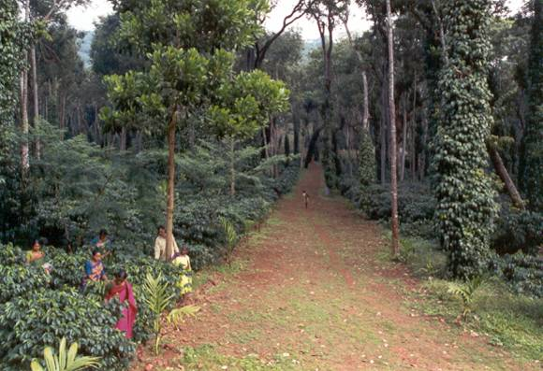
Arabica + Pepper+Jackfruit+Arecanut (India)

Slide 15
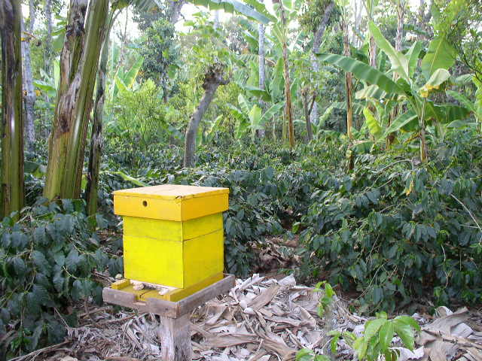
Arabica+Banana+Orange+Pepper+Bee Keeping (India)

Slide 16
Arabica + Clove (India)

Slide 17
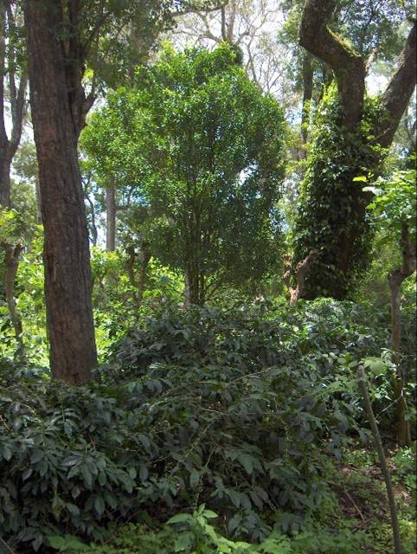
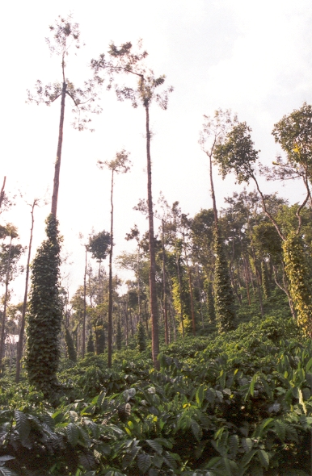
Arabica + Pepper + Orange (India)
Robusta + Pepper (India)

Slide 18
Robusta + Arecanut + Pepper (India)

Slide 19
Things to remember
During early years
Intercropping only in interspaces with clear gap of atleast 1 ft from base of coffee plants
Separate nutrition and plant protection measures to be undertaken
Avoid intercropping once coffee starts yielding
In Grown up Coffee
Maintain optimum planting density/ planting design
Separate nutrient and plant protection measures to be adopted

Slide 20
Thank You
Terima kasih

